Slide 1
Lecture 6.5 - Deep Natural Language Processing

Slide 2

The GPU Teaching Kit is licensed by NVIDIA and New York University under the
Creative Commons Attribution-NonCommercial 4.0 International License.
Deck credit: J. Weston

Slide 3

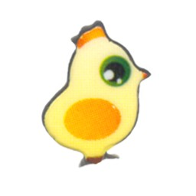


Part 1
Deep NLP tagging
Based on:
Collobert, R., Weston, J., Bottou, L., Karlen, M., Kavukcuoglu, K., & Kuksa, P. (2011). Natural language processing (almost) from scratch. The Journal of Machine Learning Research,12, 2493-2537.

Slide 4
NLP tasks
Part-Of-Speech Tagging (POS): syntactic roles (noun, adverb...)
Chunking: syntactic constituants (noun phrase, verb phrase...)
Name Entity Recognition (NER): person/company/location...
Semantic Role Labeling (SRL):
[John]_{ARG0} [ate]_{REL} [the apple]_{ARG1} [in the garden]_{ARGM−LOC}

Slide 5
Complex systems
Two extreme choice to get a complex system
Large scale engineering: design a lot of complex features, use a fast existing linear machine learning algorithm
Large scale machine learning: use simple features, design a complex model which will implicitly learn the right features

Slide 6
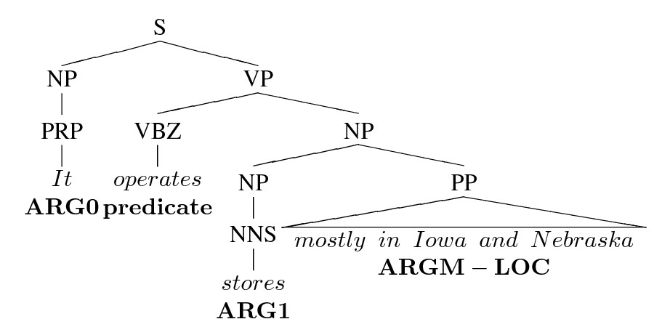
The shallow system way
Extract hand-made features e.g. from the parse tree
Disjoint: all tasks trained separately
Cascade features feed these features to a shallow classifier like SVM

Slide 7
Assert: many hand built features for SRL
Problems:
Features rely on other solutions (parsing, named entity, word-sense)
Technology task-transfer is diﬃcult
Choose some good hand-crafted features
Feed them to a shallow classiﬁer like SVM
Predicate and POS tag of predicate Phrase type: adverbial phrase, prepositional phrase Head word and POS tag of the head word Path: traversal from predicate to constituent Word-sense disambiguation of the verb Length of the target constituent (number of words) Partial Path: lowest common ancestor in path First and last words and POS in constituents Constituent tree distance Dynamic class context: previous node labels Constituent relative features: head word Constituent relative features: siblings | Voice: active or passive (hand-built rules) Governing category: Parent node’s phrase type(s) Position: left or right of verb Predicted named entity class Verb clustering NEG feature: whether the verb chunk has a ”not” Head word replacement in prepopositional phrases Ordinal position from predicate + constituent type Temporal cue words (hand-built rules) Constituent relative features: phrase type Constituent relative features: head word POS Number of pirates existing in the world

Slide 8
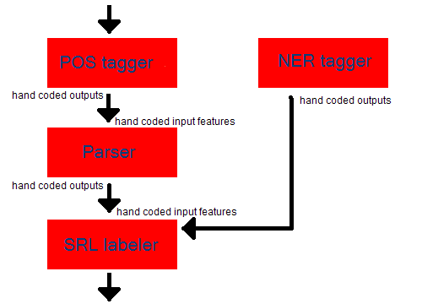

The suboptimal (?) cascade

Slide 9
NLP: large scale machine learning
Goals
Task-specific engineering limits NLP scope
Can we find unified hidden representations?
Can we build unified NLP architecture?
Means
Start from scratch: forget (most of) NLP knowledge
Compare against classical NLP benchmarks
Our dogma: avoid task-specific engineering

Slide 10
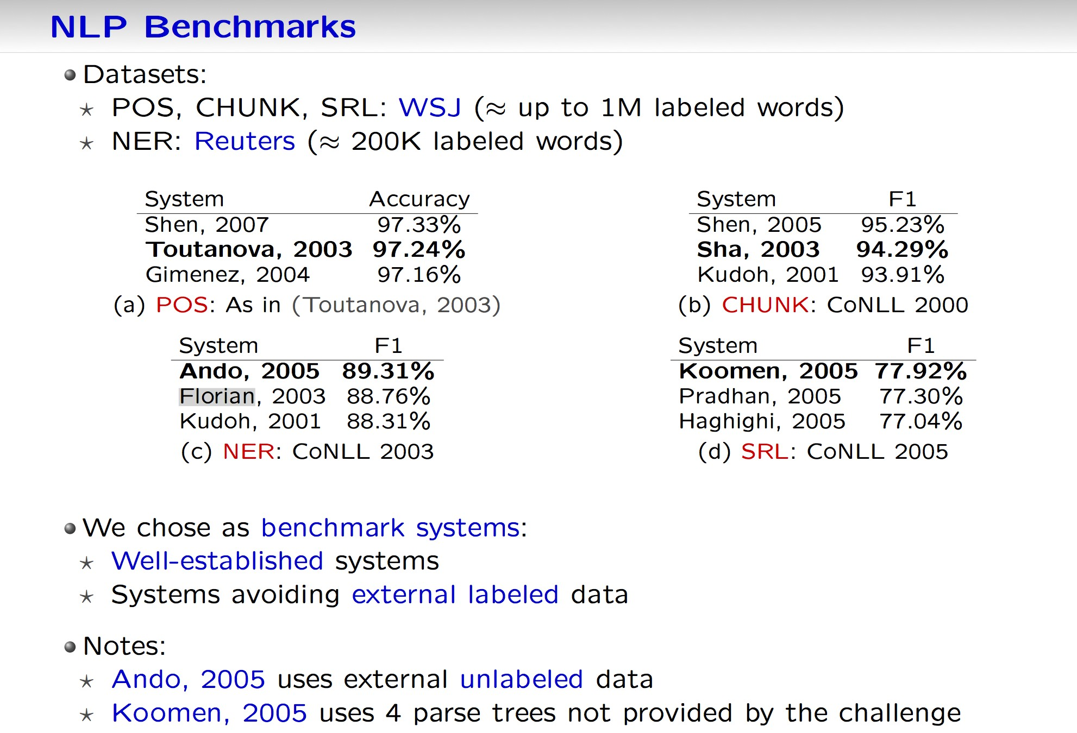
NLP benchmarks
Datasets
POS, CHUNK, SRL: WSJ (~ up to 1M labeled words)
NER: Reuters (~ 200K labeled words)
We chose as benchmark systems:
Well-established systems
Systems avoiding external labeled data
Notes:
Ando, 2005 uses external unlabeled data
Koomen, 2005 uses 4 parse trees not provided by the challenge

Slide 11
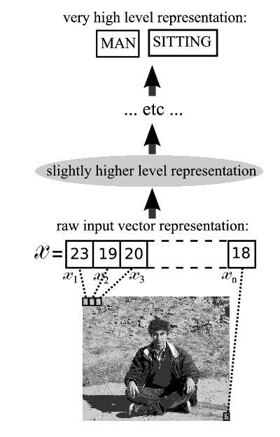
The “deep learning” way
Deep approach proposes a radically diﬀerent end-to-end approach:
Avoid building a parse tree. Humans don’t need this to talk.
Try to avoid all hand-built features → monolithic systems.
Humans implicitly learn these features. Neural networks can too. . . ?

Slide 12
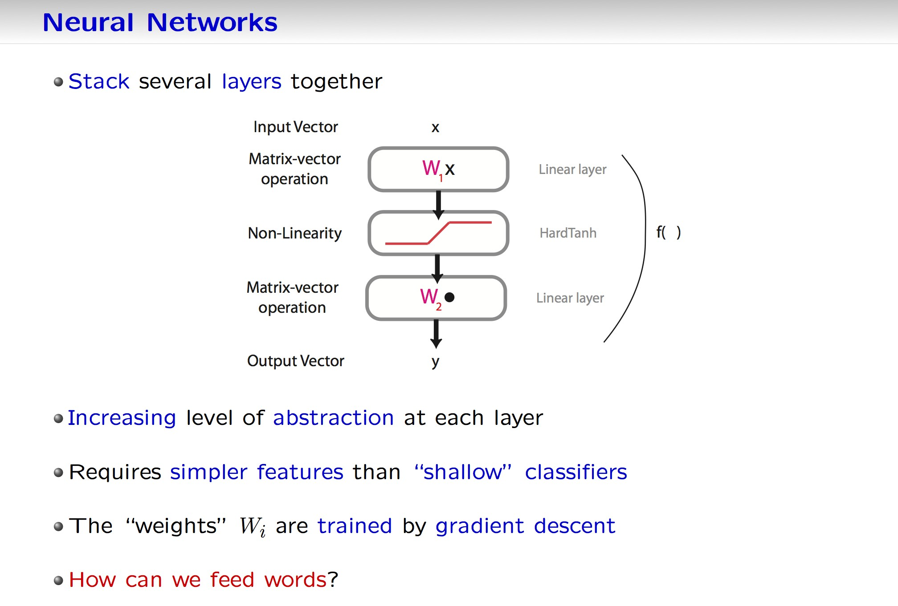
Neural networks
Stack several layers together
Increasing level of abstraction at each layer
Requires simpler features than “shallow” classifiers
The “weights” W_{i} are trained by gradient descent
How can we feed words?

Slide 13
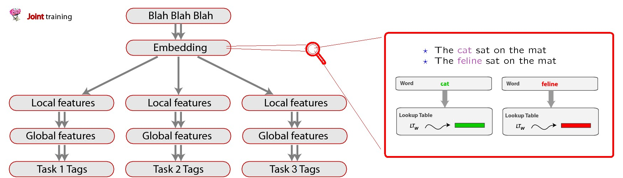
The big picture
A uniﬁed architecture for all NLP (labeling) tasks:
Sentence: | Felix | sat | on | the | mat | .
POS: | NNP | VBD | IN | DT | NN | .
CHUNK: | NP | VP | PP | NP | NP-I | .
NER: | PER | - | - | - | - | -
SRL: | ARG1 | REL | ARG2 | ARG2-I | ARG2-I | -

Slide 14
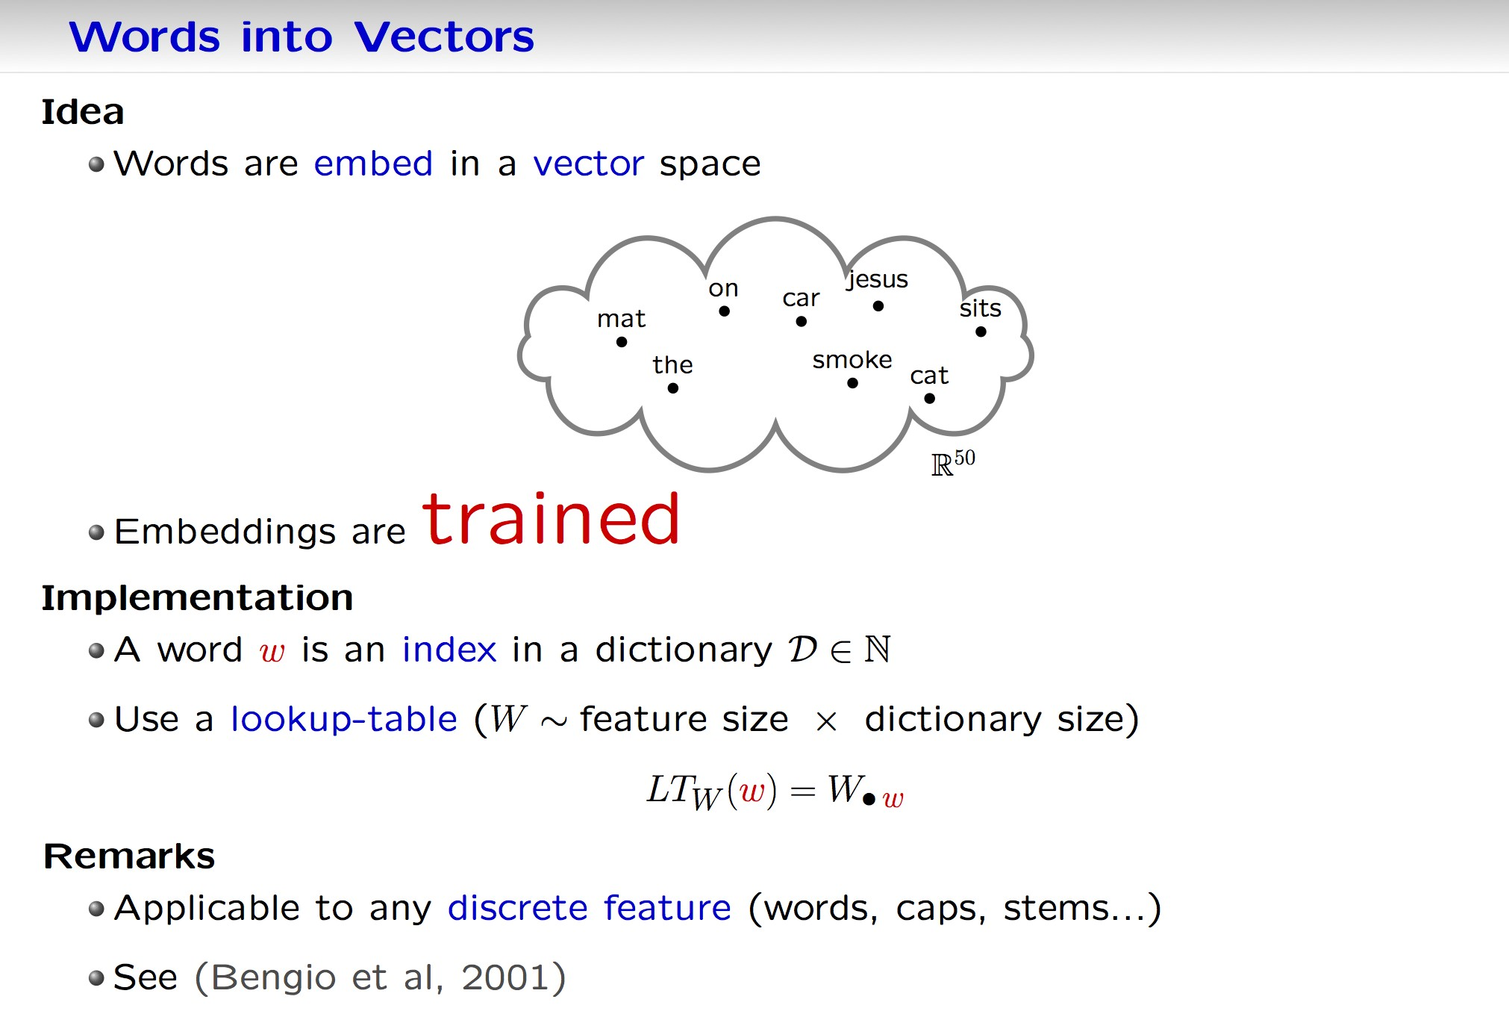
Words into vectors
Idea
Words are embed in a vector space
Embeddings are trained
Implementation
A word w is an index in a dictionary
Use a lookup-table (W ~ feature size x dictionary size)
Remarks
Applicable to any discrete feature (words, caps, stems…)
See (Bengio et al, 2001)

Slide 15
The lookup tables
Each word/element in dictionary maps to a vector in R^{d}.
We learn these vectors.
LookupTable: input of i^{th} word is
x = (0, 0, . . . , 1, 0, . . . , 0) 1 at position I
In the original space words are orthogonal.
cat = (0,0,0,0,0,0,0,0,0,1,0,0,0,0, . . . )
kitten = (0,0,1,0,0,0,0,0,0,0,0,0,0,0, . . . )
To get the R^{d} embedding vector for the word we multiply Wx where W is a d × N vector with N words in the dictionary.

Slide 16
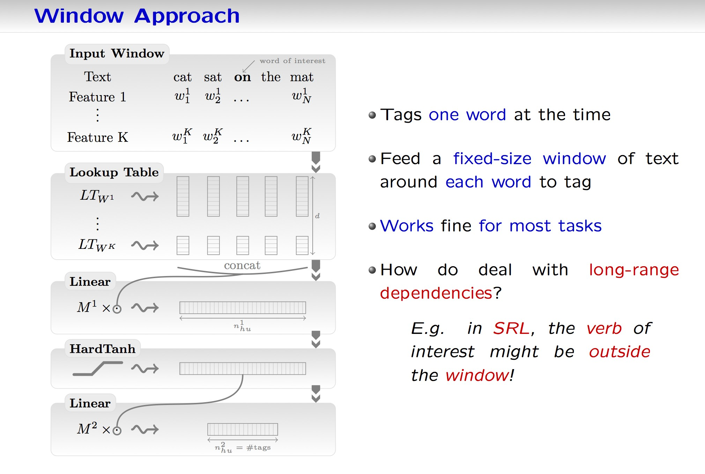
Windows approach
Tags one word at a time
Feed a fixed-size window of text around each word to tag
Works fine for most tasks
How do deal with long-range dependencies?
e.g. in SRL, the verb of interest might be outside the window!

Slide 17
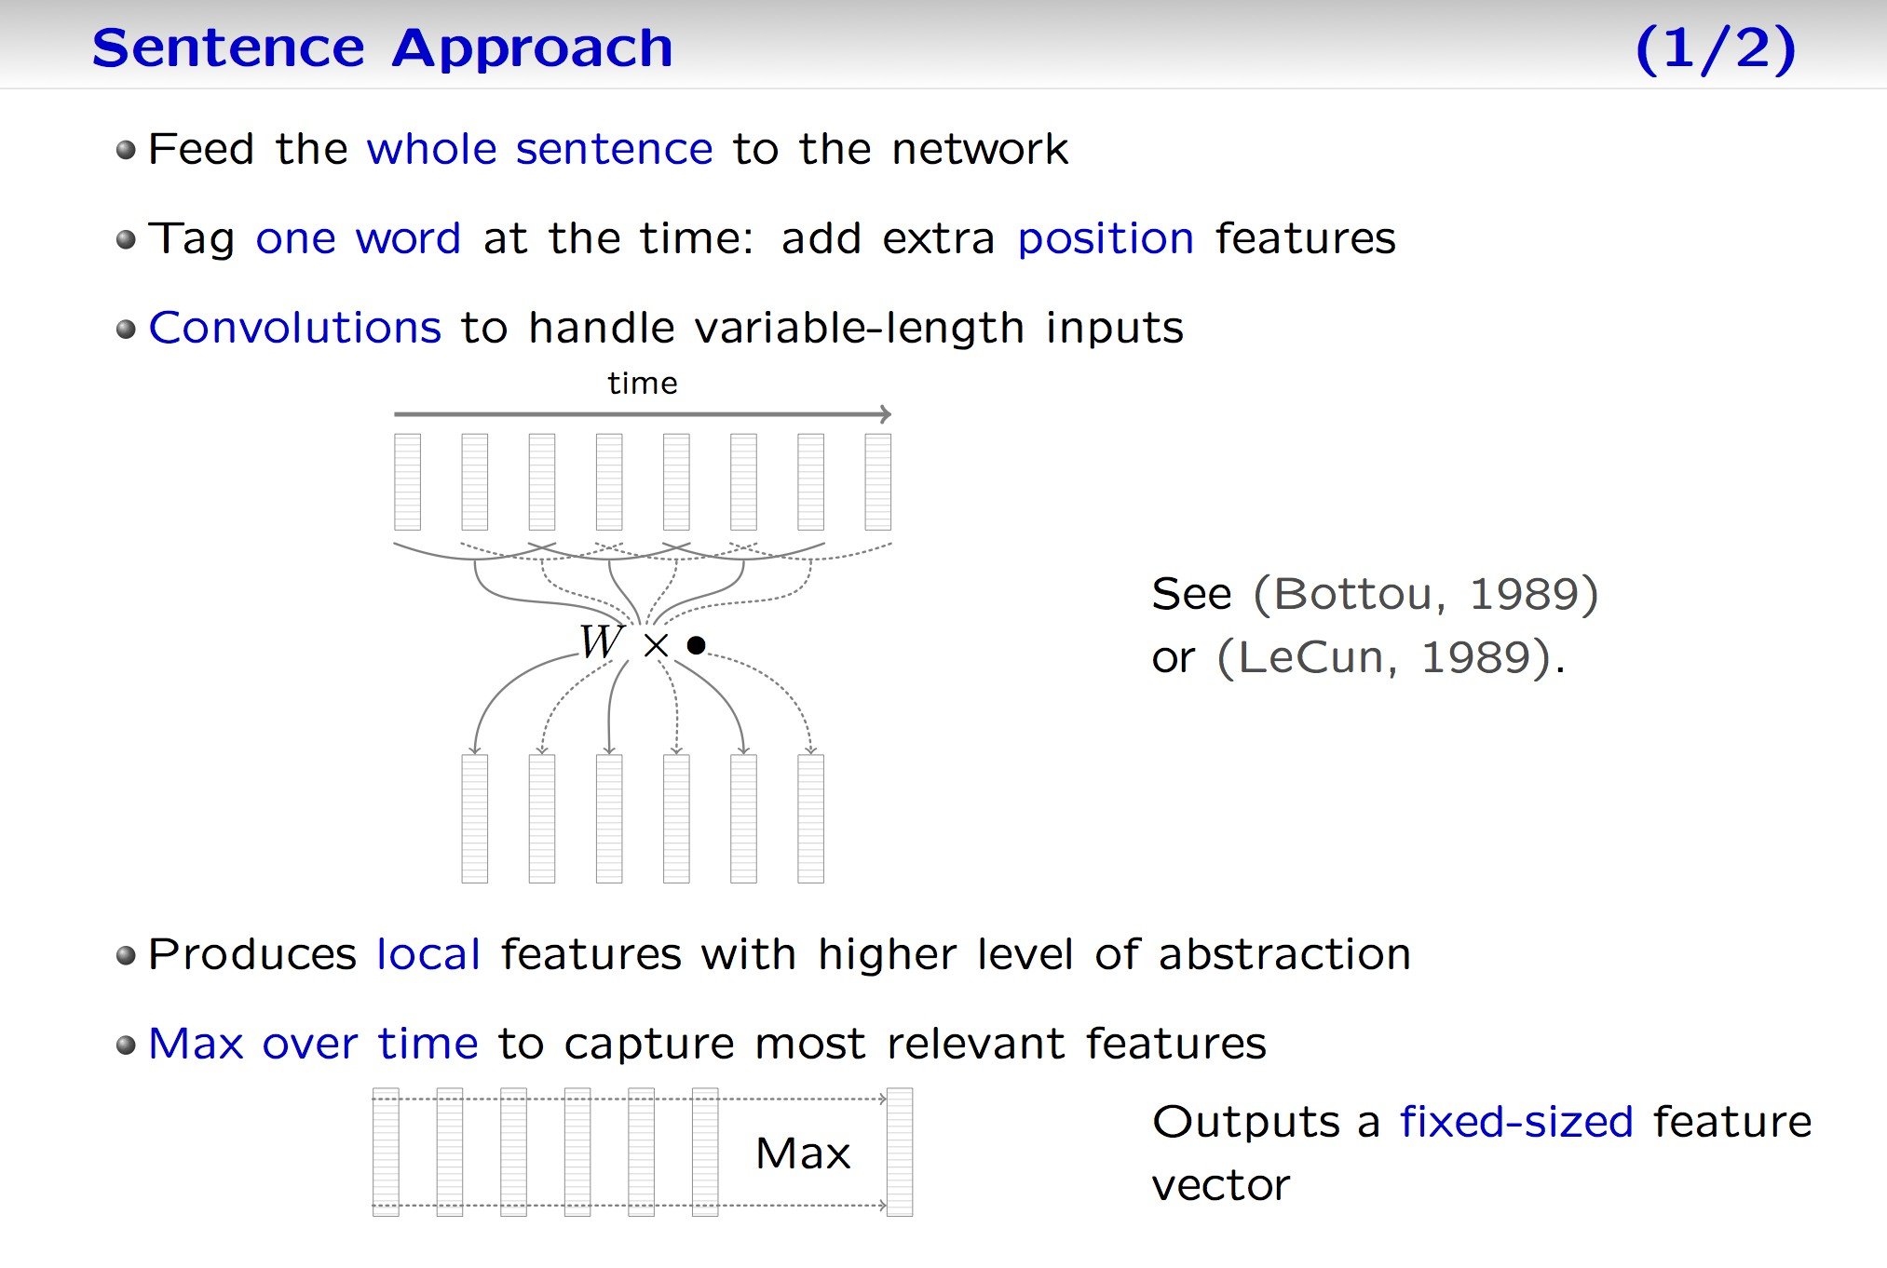
Sentence approach
Feed the whole sentence to the network
Tag one word at the time: add extra position features
Convolutions to handle variable-length inputs
See (Bottou, 1989)
Or (LeCun, 1989)
Produces local features with higher level of abstraction
Max over time to capture most relevant features
Outputs a fixed-sized feature vector

Slide 18
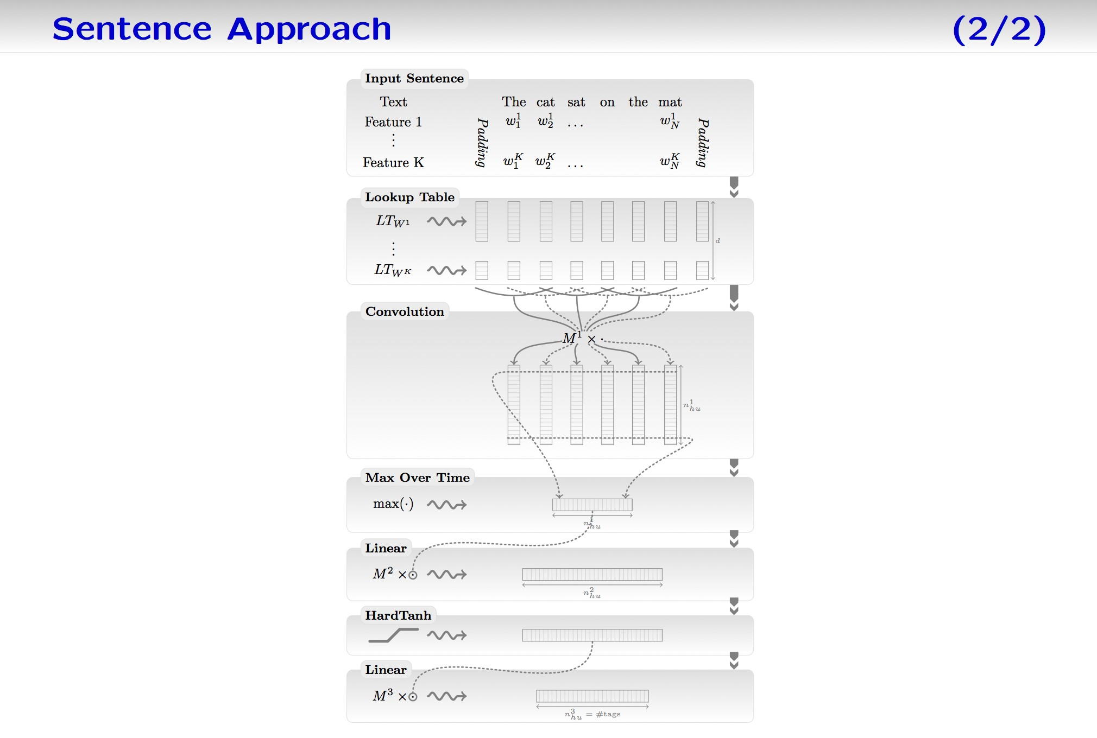
Sentence approach

Slide 19


Deep SRL
Input Sentence
word of interest
Convolution Layer
Blah Blah Blah
verb of interest
the cat sat on the mat s(1) s(2) s(3) s(4) s(5) s(6)
Local features
text
indices
pos w.rt. word pos w.r.t. verb
...
-1 0 1 2 3 4
-2 -1 0 1 2 3
Max Over Time
...
Lookup Tables
Global features
Embedding
HardTanh
LT_{w}
Linear
LT_{pw} LT_{pv}
HardTanh
Linear
Softmax
Tags
This is the network for a single window. We train/test predicting the entire sentence of tags (“structured outputs”) using viterbi approach, similar to other NLP methods.

Slide 20
Convolutions
time
x1 x2 x3
Extract local features – share weights through time/space
Used with success in image (Le Cun, 1989) and speech (Bottou & Haffner, 1989)
isz
x = (x1,x2,x3)
x
kw
W is osz*(isz*kw)
osz
Wx

Slide 21
Removing the time dimension (1/2)

Slide 22
Removing the time dimension (2/2)

Slide 23
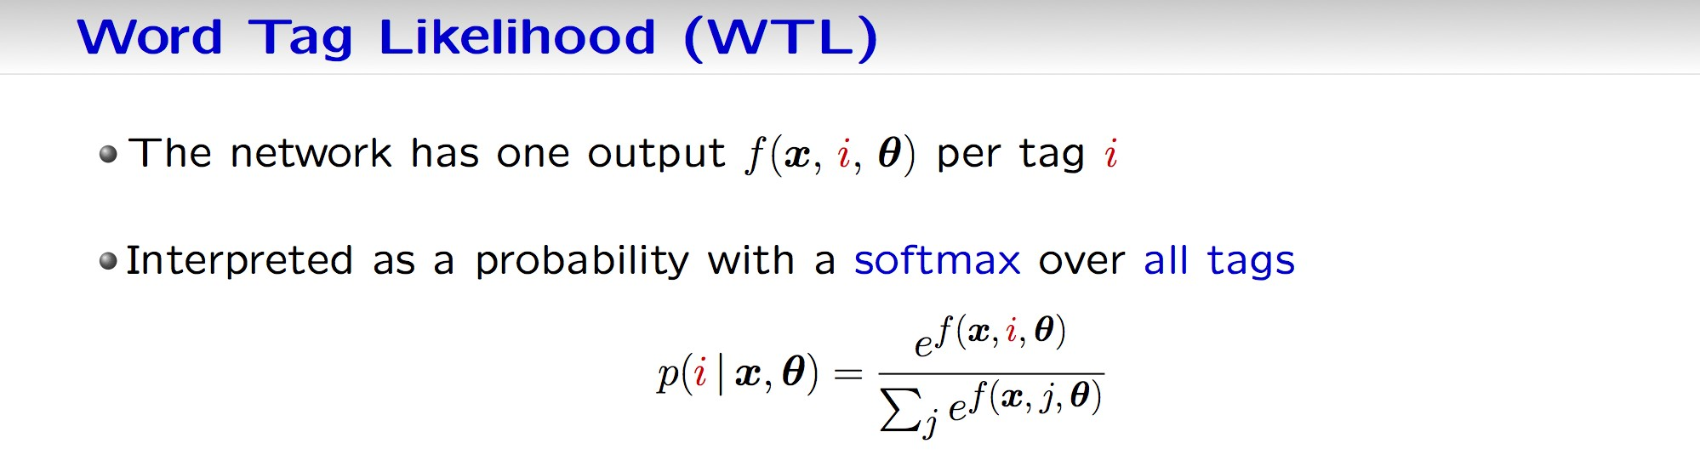
Word Tag Likelihood (WTL)
The network has one output per tag i
Interpreted as a probability with a softmax over all tags
…We can train directly for that (word tag likelihood) or we could train in a structured way by predicting the entire sentence’s tags.
That should be useful because tags are not independent.

Slide 24
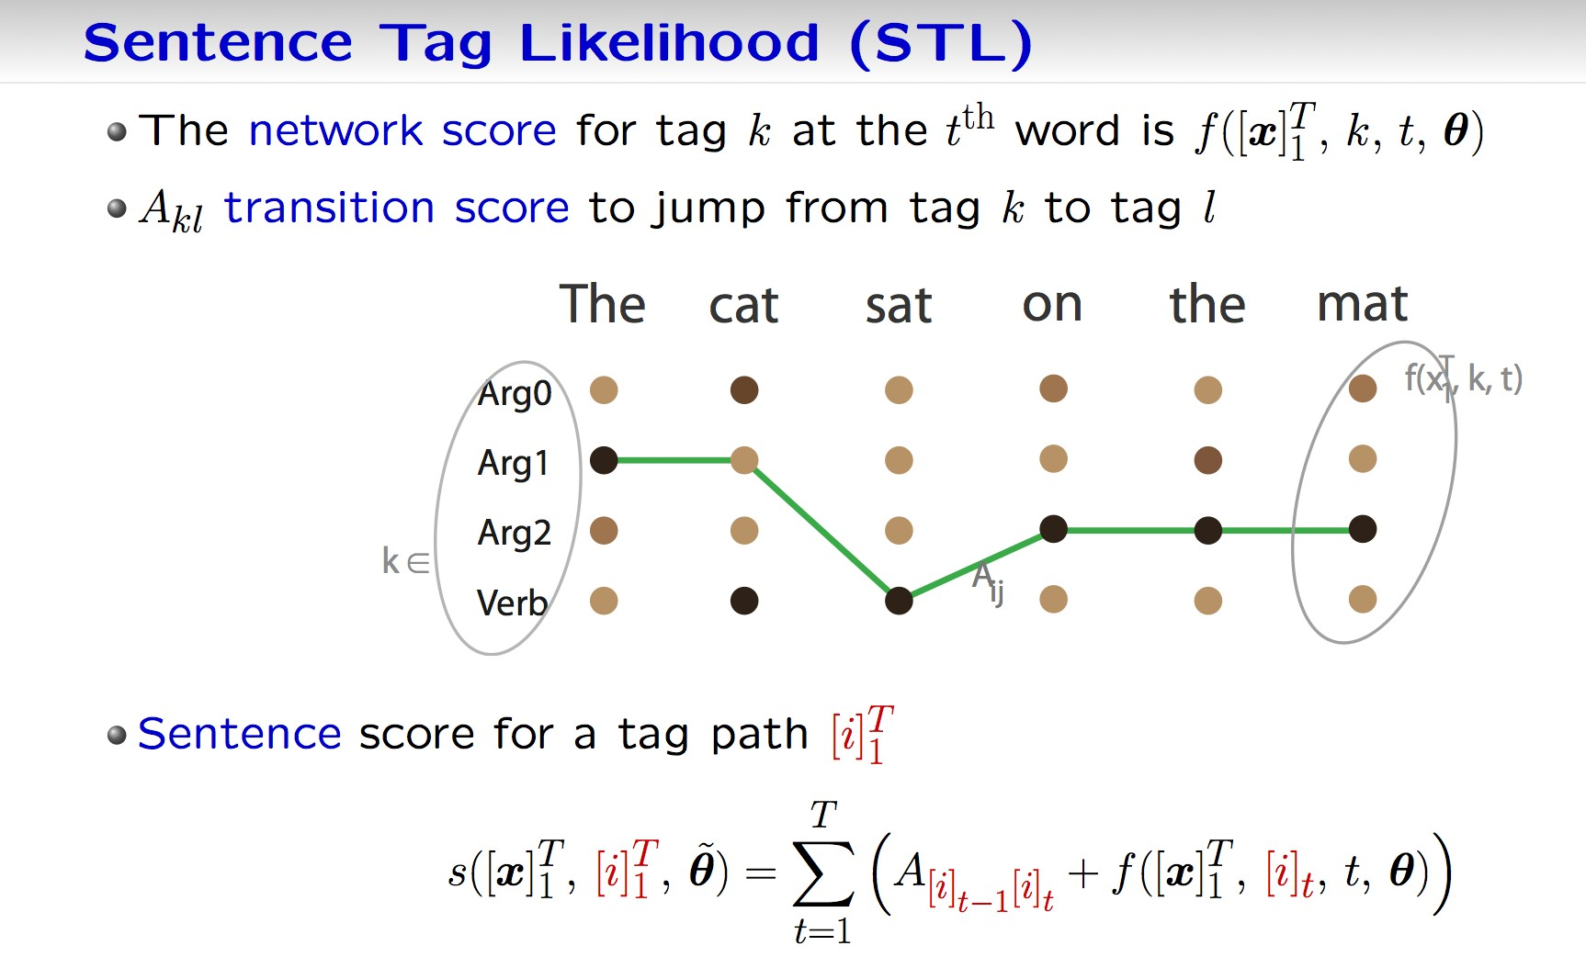
Sentence Tag Likelihood (STL)
The network score for tag k at the t^{th} word is
A_{kl} transition score to jump from tag k to tag l
Sentence score for a tag path

Slide 25
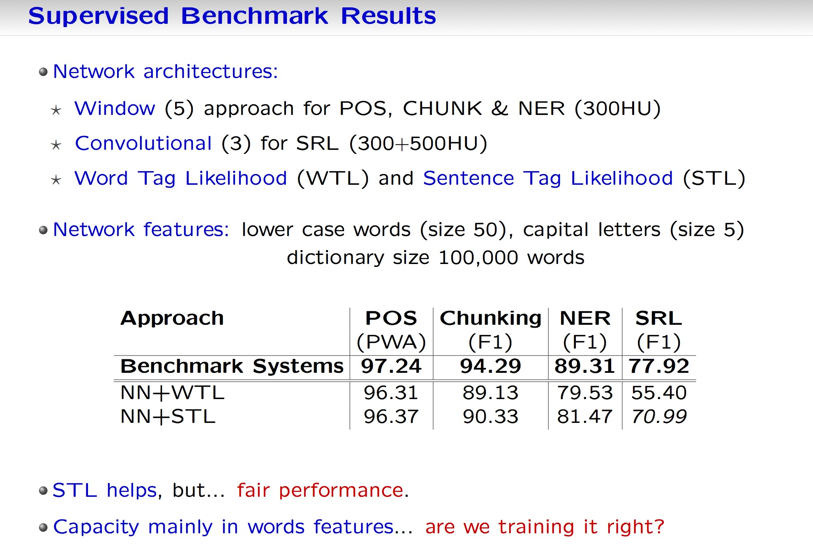
Supervised benchmark results
Network architectures:
Window (5) approach for POS, CHUNK & NER (300HU)
Convolutional (3) for SRL (300+500HU)
Word Tag Likelihood (WTL) and Sentence Tag Likelihood (STL)
Network features: lower case words (size 50), capital letters (size 5) dictionary size 100,000 words
STL helps, but… fair performance
Capacity mainly in words features… are we training it right?

Slide 26
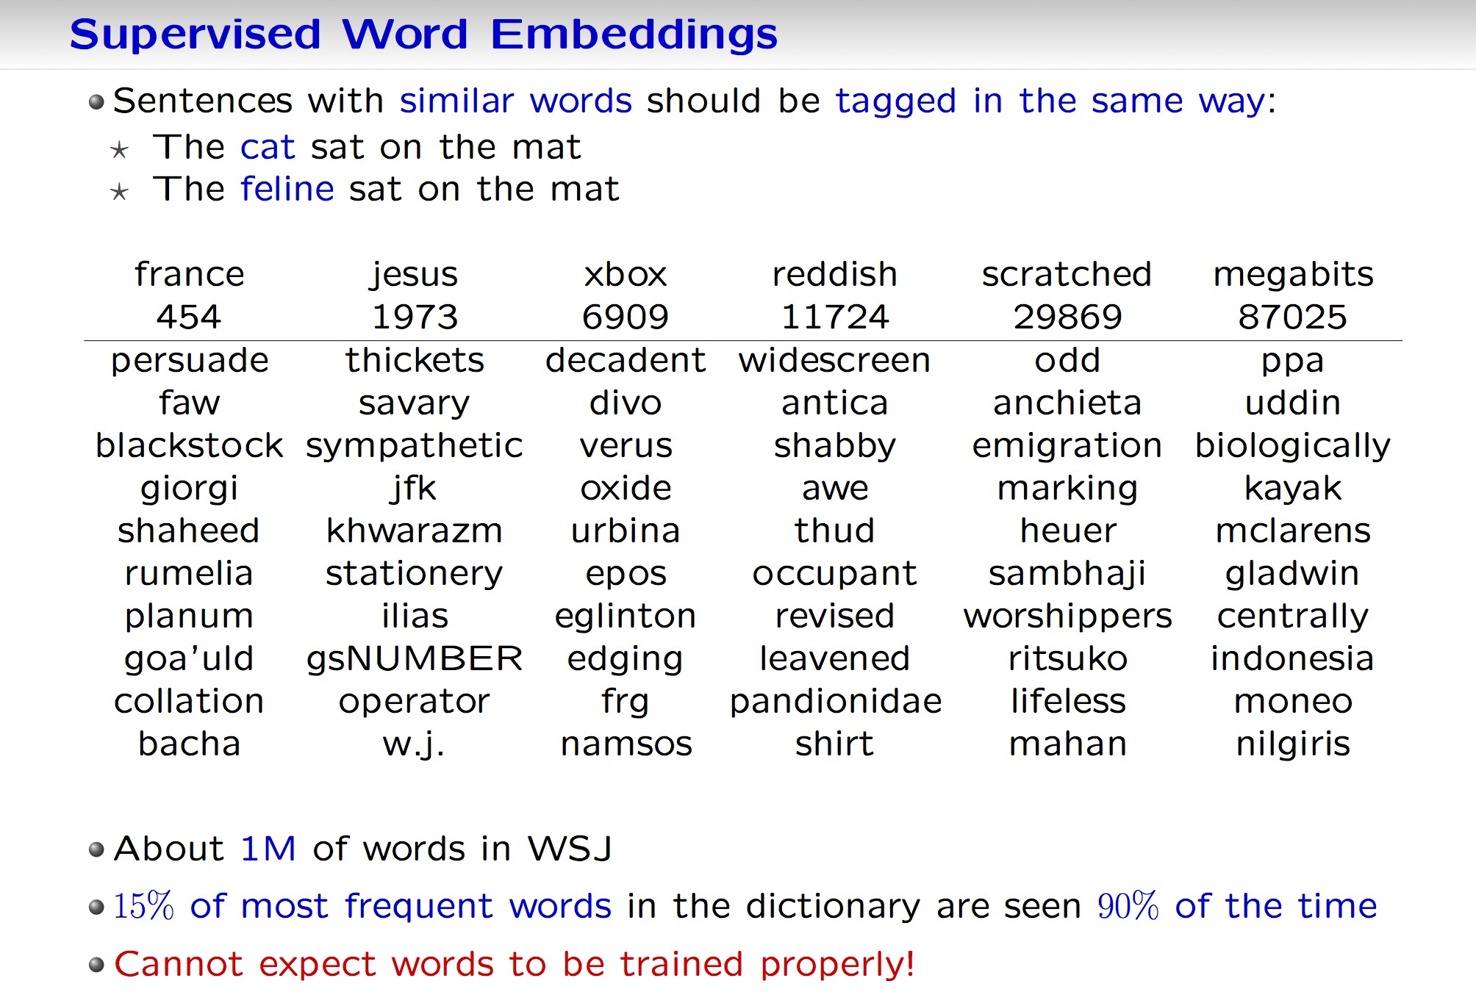
Supervised word embeddings
Sentences with similar words should be tagged in the same way:
The cat sat on the mat
The feline sat on the mat
About 1M of words in WSJ
15% of most frequent words in the dictionary are seen 90% of the time
Cannot expect words to be trained properly!

Slide 27
Improving word embedding
Rare words are not trained properly
Sentences with similar words should be tagged in the same way:
The cat sat on the mat
The feline sat on the mat
Only 1M WASJ was not enough – let’s use lots of unsupervised data!

Slide 28
Semi-supervised: MTL with unlabeled text
Language Model: “is a sentence actually English or not? ”Implicitly captures: * syntax * semantics
Bengio & Ducharme (2001) Probability of next word given previous words. Overcomplicated – we do not need probabilities here
English sentence windows: Wikipedia (∼ 631M words)
Non-English sentence windows: middle word randomly replaced
the champion Federer wins Wimbledon
vs. the champion saucepan wins Wimbledon
Multi-class margin cost:

Slide 29
Language model: embedding
Nearest neighbors in 100-dim. embedding space:
(Even fairly rare words are embedded well.)

Slide 30
Results
Notes:
Didn’t compare to benchmarks that used external labeled data.–
[Ando ’05] uses external unlabeled data.–
[Koomen ’05] uses 4 parse trees not provided by the challenge. Using only 1 tree it gets 74.76.

Slide 31
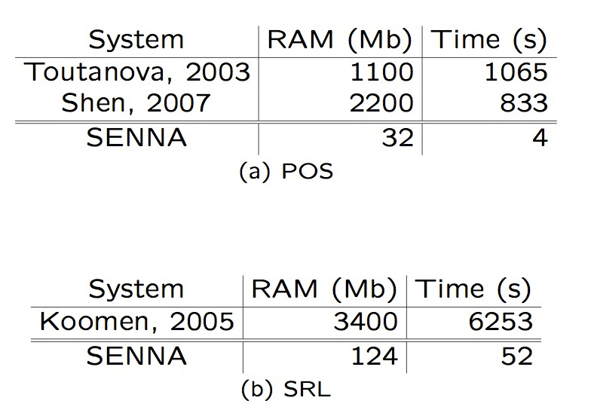
Software
Code for tagging with POS, NER, CHUNK, SRL + parse trees:
http://ml.nec-labs.com/senna/
See also Torch: http://www.torch.ch

Slide 32
Conclusion: Deep learning for NLP tagging
Generic end-to-end deep learning system for NLP tasks
Previous common belief in NLP: engineering syntactic features necessary for semantic tasks.
One can do well by engineering an algorithm rather than features.
Attitude is changing in recent years...

Slide 33
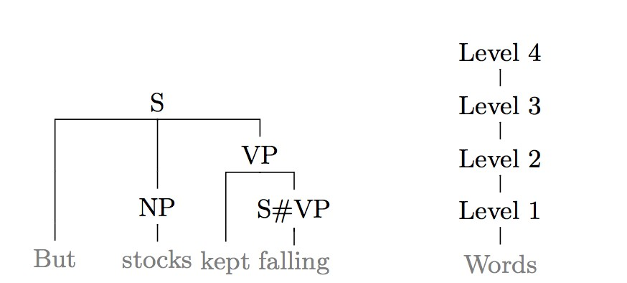
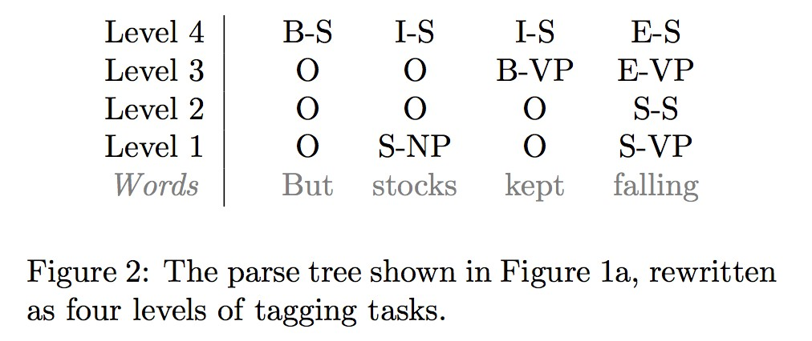
Other Deep NLP work: Parsing
Solve as a (structured) tagging task, similar to methods before.
R. Collobert. Deep Learning for Eﬃcient Discriminative Parsing. In AISTATS, 2011.

Slide 34
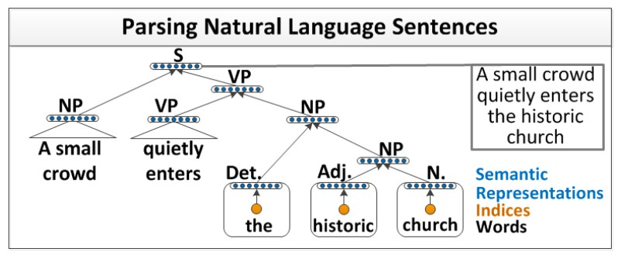
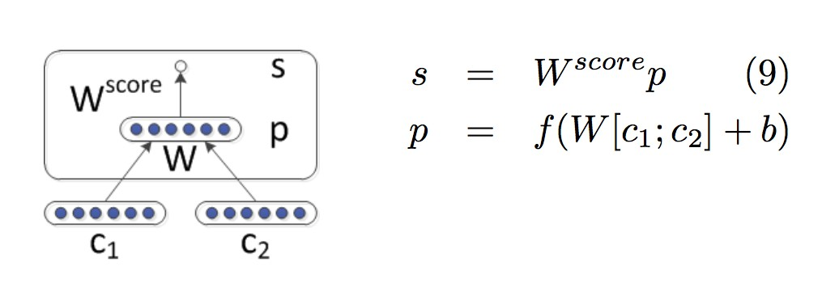
Other Deep NLP work: Recursive NNs for parsing, sentiment, ...
Socher, Richard, et al. “Parsing natural scenes and natural language with recursive neural networks.” Proceedings of the 28th International Conference on Machine Learning (ICML-11). 2011.
Socher, Richard, et al. “Recursive deep models for semantic compositionality over a sentiment treebank.” Proceedings of the Conference on Empirical Methods in Natural Language Processing (EMNLP). 2013.

Slide 35
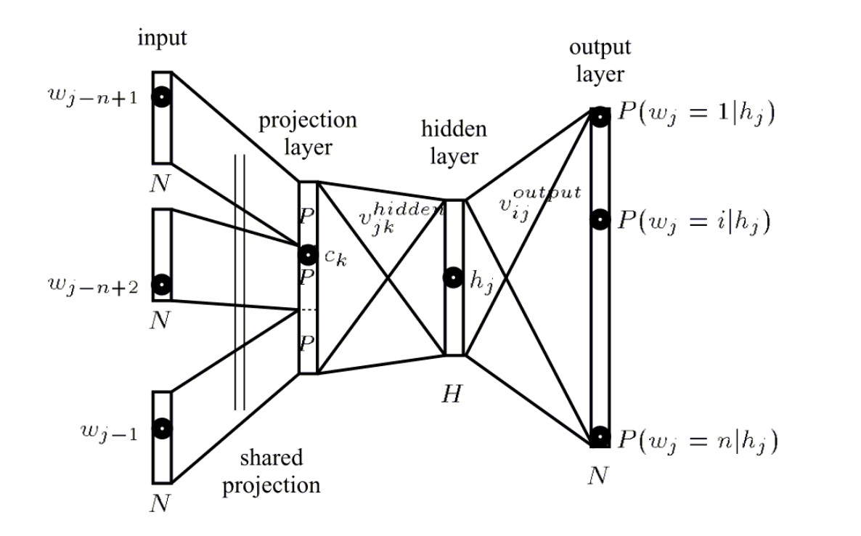
Other Deep NLP work: Language models
Bengio, Y., Schwenk, H., Sencal, J. S., Morin, F., & Gauvain, J. L.(2006). Neural probabilistic language models. In Innovations in Machine Learning (pp. 137-186). Springer Berlin Heidelberg.

Slide 36
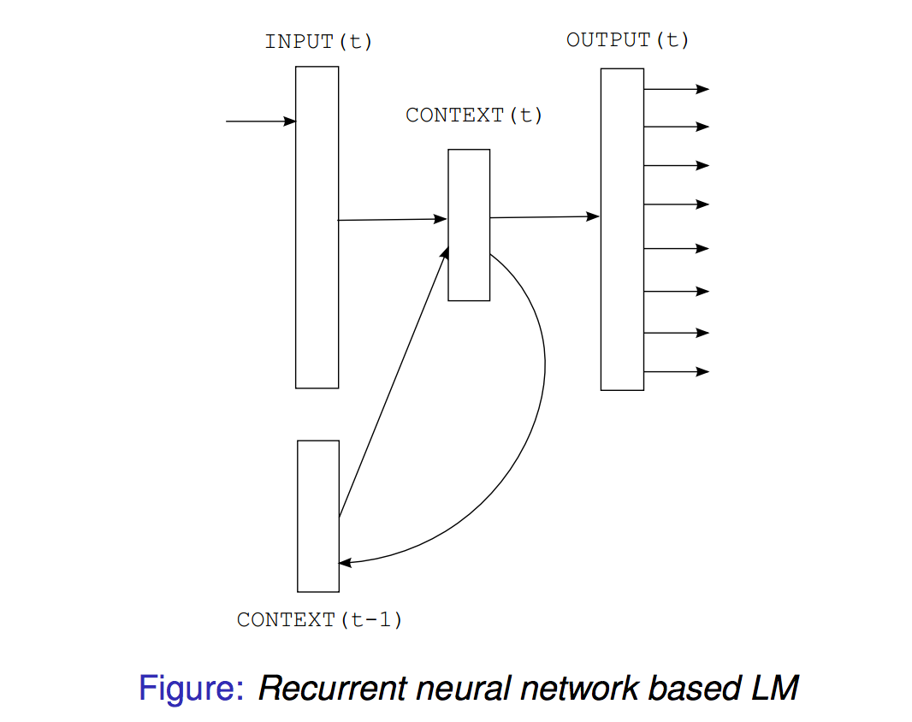
Other Deep NLP work: RNN LMs
Recurrent neural network based language model. T Mikolov, M Karaﬁt, L Burget, J Cernock, S Khudanpur INTERSPEECH, 1045-1048.

Slide 37
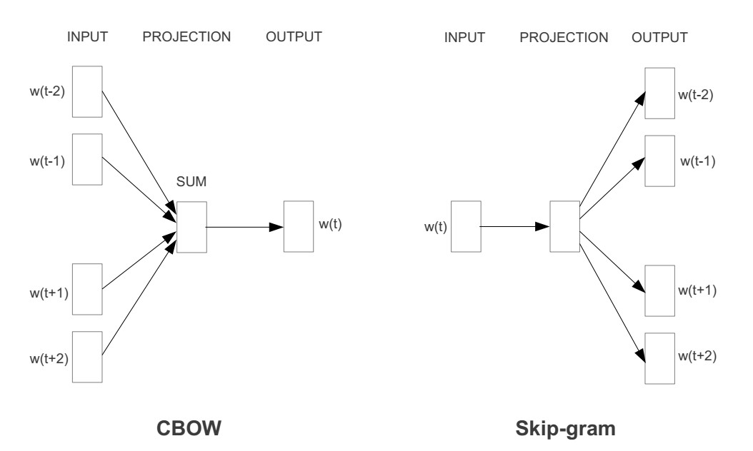
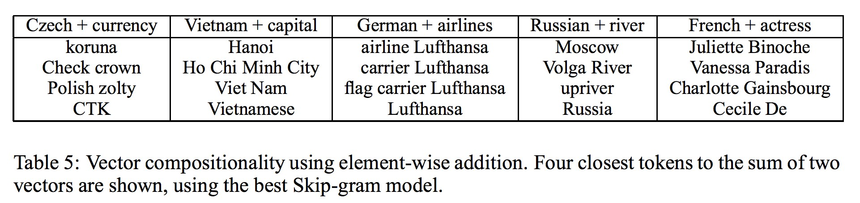
Other Deep NLP work: word2vec LMs
Tomas Mikolov, Ilya Sutskever, Kai Chen, Greg Corrado, and Jeﬀrey Dean. Distributed Representations of Words and Phrases and their Compositionality. NIPS, 2013.

Slide 38
Work on using text embedding for semantics:
More work that I have done (with co-authors):
A. Bordes, X. Glorot, J. Weston and Y. Bengio. Joint Learning of Words and Meaning Representations for Open-Text Semantic Parsing. AISTATS 2012.
A. Bordes, J. Weston, R. Collobert and Y. Bengio. Learning Structured Embeddings of Knowledge Bases. AAAI 2011.
A. Bordes, N. Usunier, R. Collobert, J. Weston.Towards Understanding Situated Natural Language. AISTATS, 2010.
They use similar tools to incorporate world knowledge into text understanding by embedding concepts and words in a joint space.

Slide 39
Work on using text embedding for IR:
More work that I have done (with co-authors):
B. Bai, J. Weston, D. Grangier, R. Collobert, K. Sadamasa, Y. Qi, C. Cortes, M. Mohri. Polynomial Semantic Indexing. NIPS, 2009.
J. Weston, S. Bengio, N. Usunier. Large Scale Image Annotation: Learning to Rank with Joint Word-Image Embeddings. ECML PKDD 2010 special issue of the Machine Learning journal.
A. Lucchi and J. Weston. Joint Image and Word Sense Discrimination For Image Retrieval. ECCV 2012.
They use similar tools to perform retrieval, the latter two using embeddings of words and images in a joint space.

Slide 40
Thank you

